Slide 1
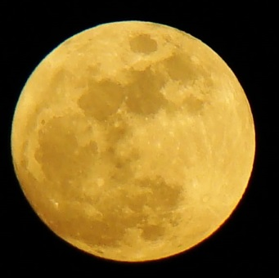







POOL
Twinbrook
Living Faith
Swimming
&
Lutheran Church
Invites you to
National Night Out
When: August 1, 2017, 6:00 – 9:00pm
Where: Twinbrook Swimming Pool
13027 Atlantic Avenue, Rockville, MD 20851
What: Get to know neighbors, swim, enjoy a picnic, and
learn how to maintain a safe community!
      Featuring South Meets East Food Truck
      Moon Bounce for the kids
      Bring: Picnic and $6 to swim (free for pool members)
      No Glass Please!
RSVP: RSVP by July 28 ​to Brigitta Mullican, 301-230-0890, or coburg1@verizon.net.
Notes:
Added a space in RSVP line between 28 & to

